Slide 1

Unicorn Companies
PYTHON FOR DATA ANALYTICS PROJECT 2023 – APRIL DAF

Slide 2
CONTENTS
Introduction
Analysis Aim and Objectives
Data Exploration and processing
Analysis Findings and Results
Conclusion and Recommendation

Slide 3


These companies have all achieved great success in their respective industries, and they are seen as leaders in the future of technology. Unicorn companies are often characterized by their innovative business models, their rapid growth, and their ability to attract top talent.
A unicorn company is a privately held startup company with a valuation of over US$1 billion. The term was first coined by venture capitalist Aileen Lee in 2013. Unicorn companies are very rare, and they are often seen as the next generation of tech giants.

Slide 4
# import the necessary libraries import numpy as np import pandas as pd import scipy.stats as stats # for visuals import seaborn as sns import matplotlib.pyplot as plt import plotly import plotly.express as px from matplotlib.pyplot import figure from plotly.offline import init_notebook_mode, iplot import plotly.graph_objects as go %matplotlib inline
The analysis was carried out firstly by importing the below libraries, there after a cleaning of the data was done to remove missing values, replace null values, rename columns and create new columns for year and Total years Joined.
There are 1074 rows and 10 columns in the dataframe. It takes an average of 7 years to become a unicorn and the most valued Industry are Fintech companies. The most valuable unicorn company from this dataset is Bytedance which is valued at 180 Billion Dollars; it is important to note that a company needs to be valued at $1B to be considered a unicorn.

Slide 5
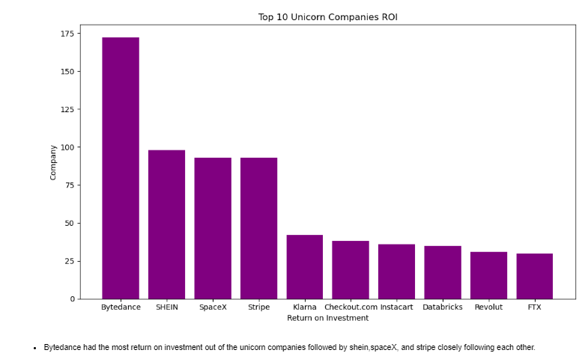
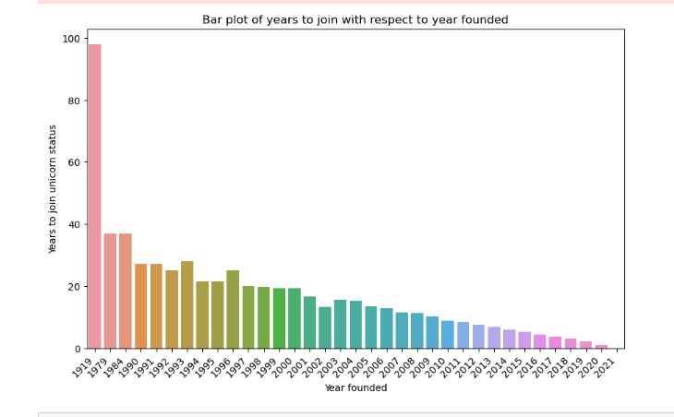
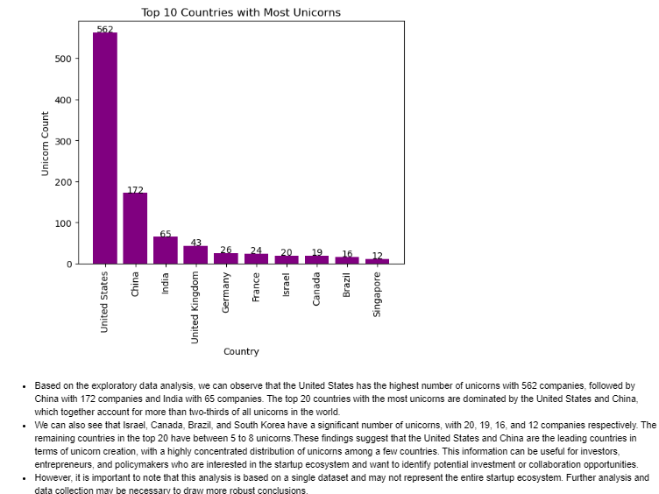
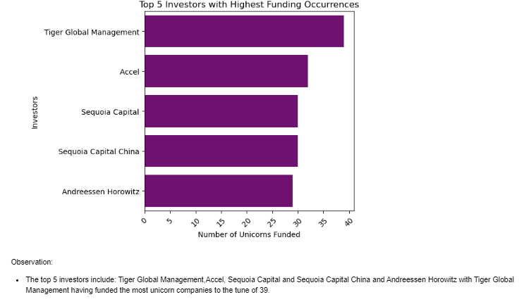
Some graphical REPRESENTATIONS OF INSIGHTS GENERATED

Slide 6

It takes an average of 7 years to become a unicorn and the most valued Industry are Fintech companies.
The most valuable unicorn company from this dataset is Bytedance which is valued at 180 Billion Dollars; it is important to note that a company needs to be valued at $1B to be considered a unicorn.
United States has 562 unicorn companies which makes it the largest country in the world with unicorn companies and it is almost triple the size of china unicorn companies which comes after US.
San Francisco is a good city to start a company as it is an industry hub with a total of 152 unicorn companies to a value of 724b followed by New York with 103 unicorn companies and Beijing and Shanghai having 63 and 43 unicorn companies respectively.
Analysis Findings and Results

Slide 7
Recommendations
Focus on companies founded after 2010 as they have higher growth potential
Prioritize companies with over $500 million in funding as a proxy for growth
Invest in companies with experienced leadership teams (age >40)
Diversify portfolio with companies across categories like Ecommerce, Fintech etc.
Focus on product development. The best way to improve your business is to focus on developing products that your customers love. This means understanding your customers' needs and pain points, and then developing products that solve those problems.
Another way to grow your business is through acquisitions. This means buying smaller companies that are in related industries. This can be a good way to enter new markets, acquire new customers, and gain new skills and technologies

Slide 8


